Slide 1
Question Answering ChatBot
Sajjad Mehrpeyma

Slide 2
Data Gathering
Where are the questions?

Slide 3
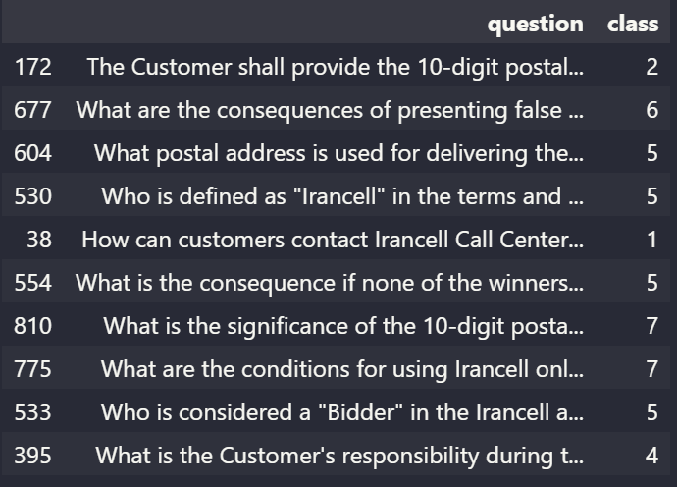
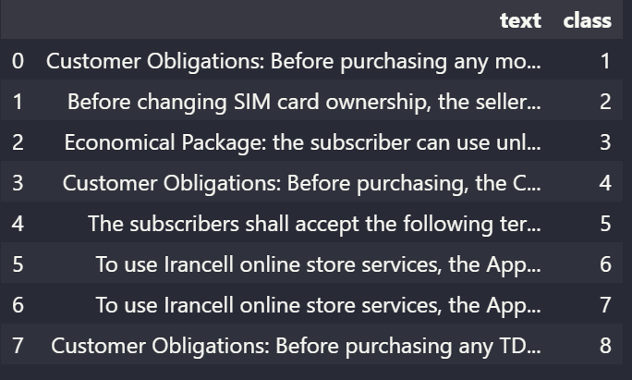
Data Gathering
1016 Questions Generated by ChatGPT
Original texts categorized into 8 classes

Slide 4
Model Design & Workflow
Question

Slide 5
Model Design & Workflow
Question
PreProcessing

Slide 6
Model Design & Workflow
Question
PreProcessing
Tokenization
&
Embedding
(Glove)

Slide 7
Model Design & Workflow
Question
PreProcessing
Tokenization
&
Embedding
(Glove)
Question
Classifier
Model*

Slide 8
Model Design & Workflow
Question
Related Text
PreProcessing
Text Corpus
Tokenization
&
Embedding
(Glove)
Question
Classifier
Model*

Slide 9
Model Design & Workflow
Question
Related Text
Bert Base Cased
PreProcessing
Text Corpus
Bert
Fine Tuning On SQuAD
Tokenization
&
Embedding
(Glove)
Question
Classifier
Model*

Slide 10
Model Design & Workflow
Question
Related Text
Bert Base Cased
PreProcessing
Text Corpus
Bert
Fine Tuning On SQuAD
Tokenization
&
Embedding
(Glove)
Question
Classifier
Model*
Answer

Slide 11
Question Classifier Model
Question1
Bidirectional
LSTM
Distance Vector
0 / 1
Distance Layer
Dense
Same Class or Not
Question2

Slide 12
Question Classifier Model
Question
Vector
Bidirectional
LSTM
1 ~ 8
Question
Dense
Multi Class Classification
Freezed

Slide 13
SQuAD Dataset
107,785 question-answer pairs on 536 articles from Wikipedia
Provided by Stanford University

Slide 14
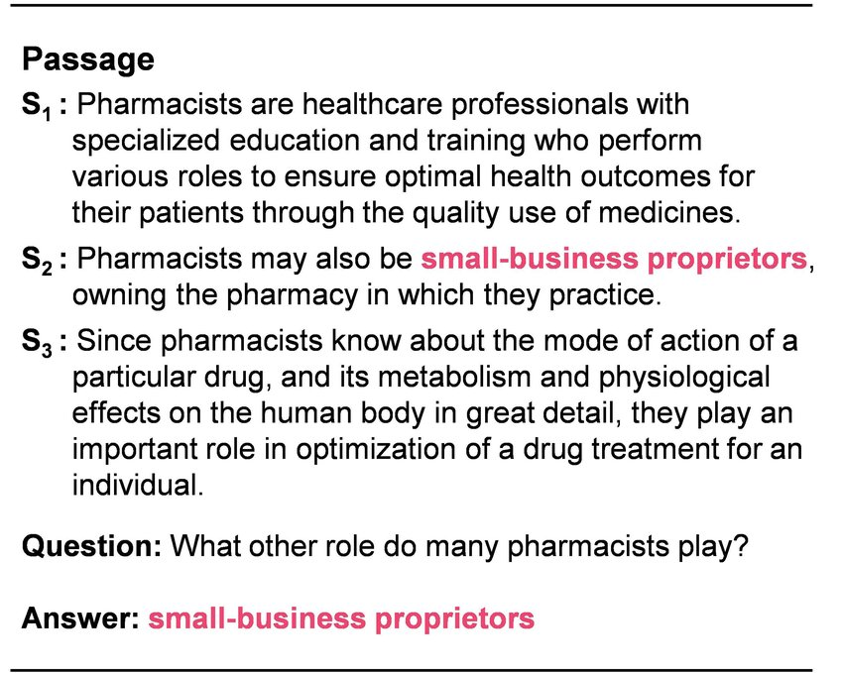
SQuAD Dataset

Slide 15
Metrics
Question Classifier Model: (Loss=Categorical Cross Entropy, Optimizer=RMS Prop)
Val-Accuracy: 79.9%
Val-Loss: 0.94

Slide 16
Metrics
Question Classifier Model: (Loss=Categorical Cross Entropy, Optimizer=RMS Prop)
Val-Accuracy: 79.9%
Val-Loss: 0.94
Bert Fine Tuned On SQuAD:
Val-F1-Score: 88.6%
Val-Exact Match: 80.9%

Slide 17
Challenges
Dataset quality is bounded by ChatGPT.

Slide 18
Challenges
Dataset quality is bounded by ChatGPT.
Similar Questions but different answers in fields like Delivery.

Slide 19
Challenges
Dataset quality is bounded by ChatGPT.
Similar Questions but different answers in fields like Delivery.
PreProcessing improved question classifier accuracy about 15%

Slide 20
Goals
Handling Multi Questions per Query.

Slide 21
Goals
Handling Multi Questions per Query.
Better & more accurate Metrics.

Slide 22
Goals
Handling Multi Questions per Query.
Better & more accurate Metrics.
Dockerizing the whole project.

Slide 23
Goals
Handling Multi Questions per Query.
Better & more accurate Metrics.
Dockerizing the whole project.
Implementing UI for ChatBot.

Slide 24
Goals
Handling Multi Questions per Query.
Better & more accurate Metrics.
Dockerizing the whole project.
Implementing UI for ChatBot.
Train model on other Q/A datasets.

Slide 25
Goals
Handling Multi Questions per Query.
Better & more accurate Metrics.
Dockerizing the whole project.
Implementing UI for ChatBot.
Train model on other Q/A datasets.
Maybe using a generative network for better looking answers.

Slide 26
Goals
Handling Multi Questions per Query.
Better & more accurate Metrics.
Dockerizing the whole project.
Implementing UI for ChatBot.
Train model on other Q/A datasets.
Maybe using a generative network for better looking answers.
Automate the process of data gathering and prediction.

Slide 27
Thank You
27

